Slide 1

Drama Class
First Semester 2018

Slide 2

Introduction to Theatre
This includes: what is theatre?
how to stand on stage ?
What are the Theatre manners?

Slide 3

Skills Learned
Personality Skills
Acting Skills
Language Skills

Slide 4
First Personality Skills
Self Confidence
Team Work
Body Language expressions
Motivation and Commitment
Flexibility and problem solving

Slide 5
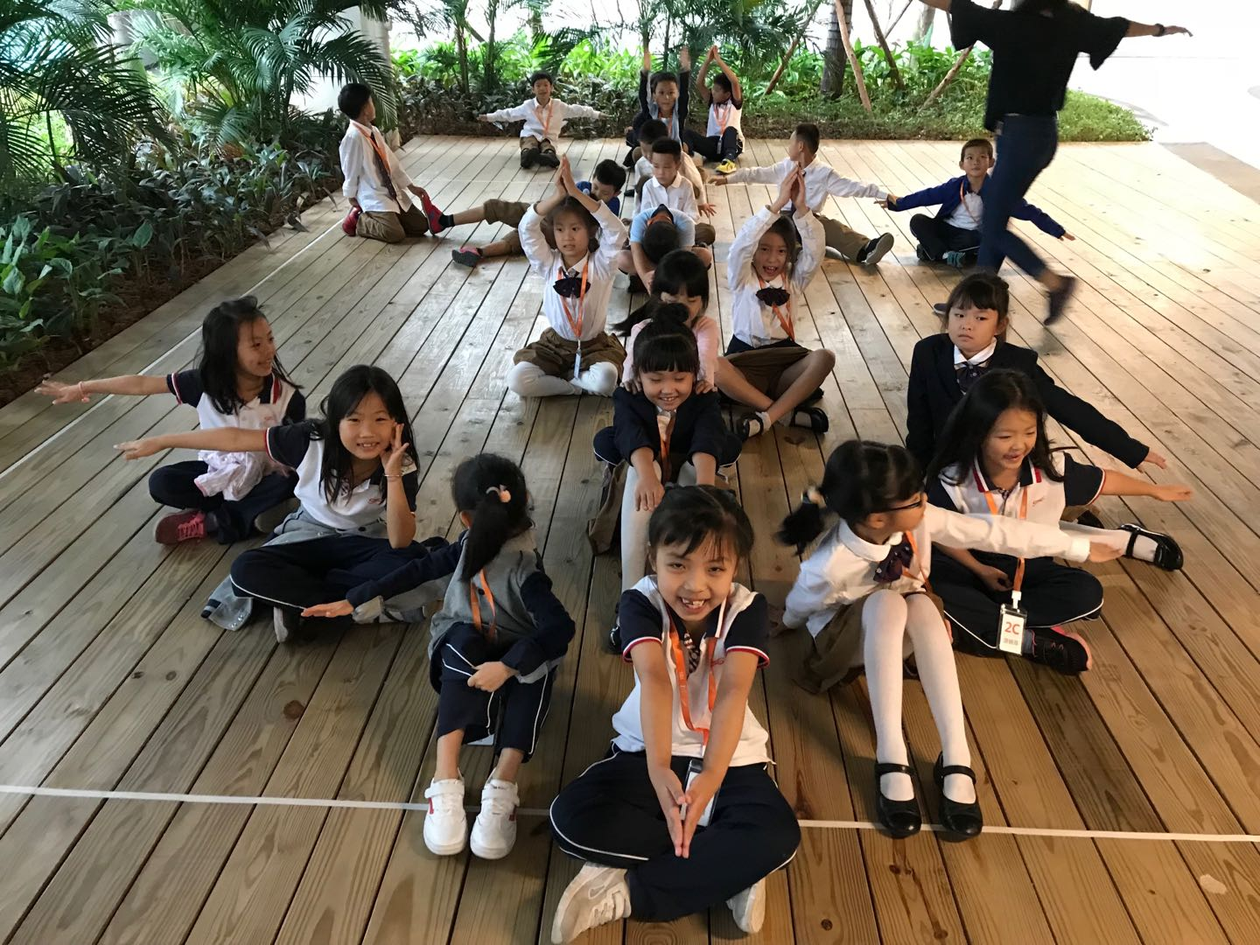

Slide 6

Second Acting Skills
Taking directions
Observation skill
Imagination and creativity
Focus skill
Emotions basics
Part One

Slide 7
Second Acting Skills
Improv
Movement and sense of space (Where)
Characters basics (Who)
Objectives and Tactics Basics (what)
Part Two

Slide 8
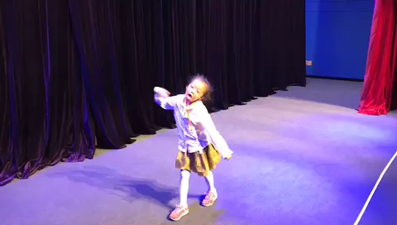

Slide 9
Third Language Skills (Listening and Speaking)
Students learn new vocabulary each class: taking directions on stage, places they act, characters they play, actions they do, Stories…etc.

Slide 10



Created 2 Plays

Slide 11
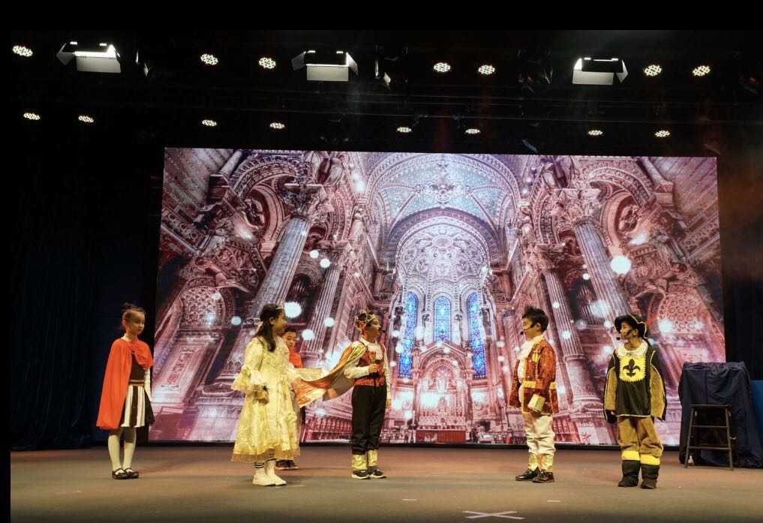
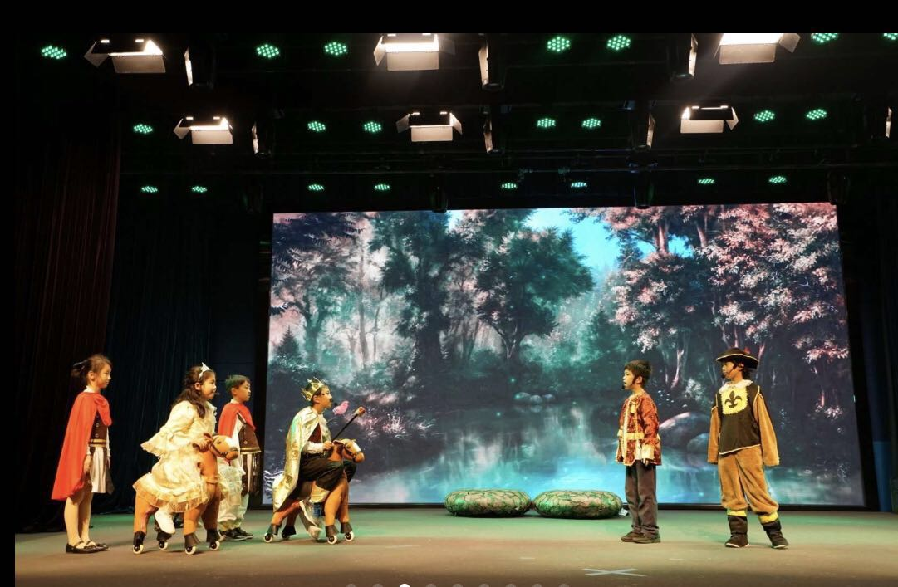

Slide 12
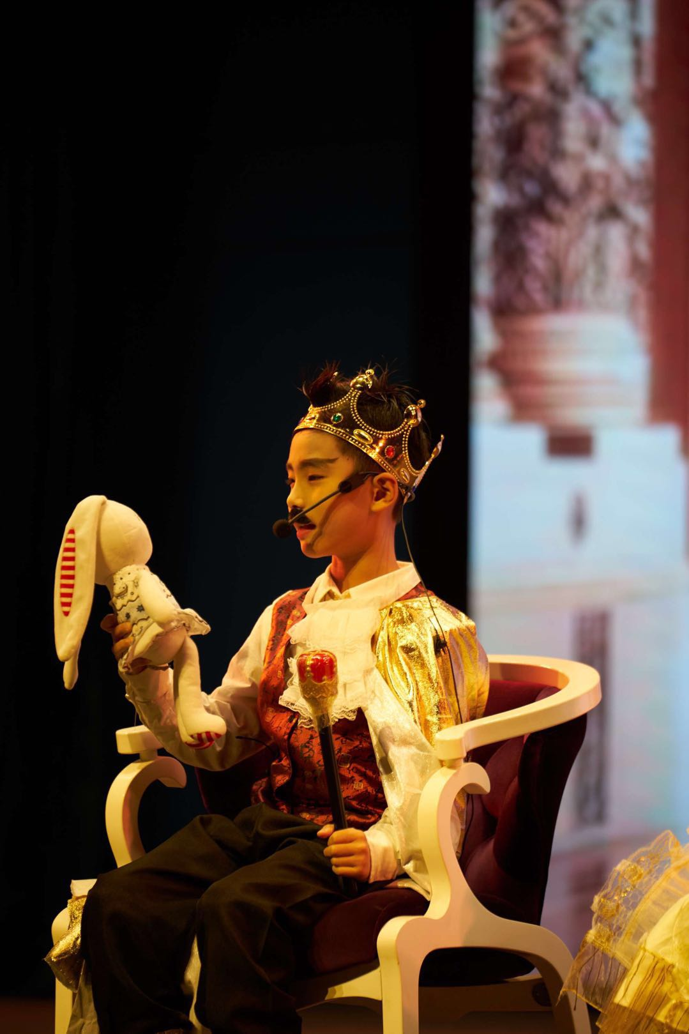
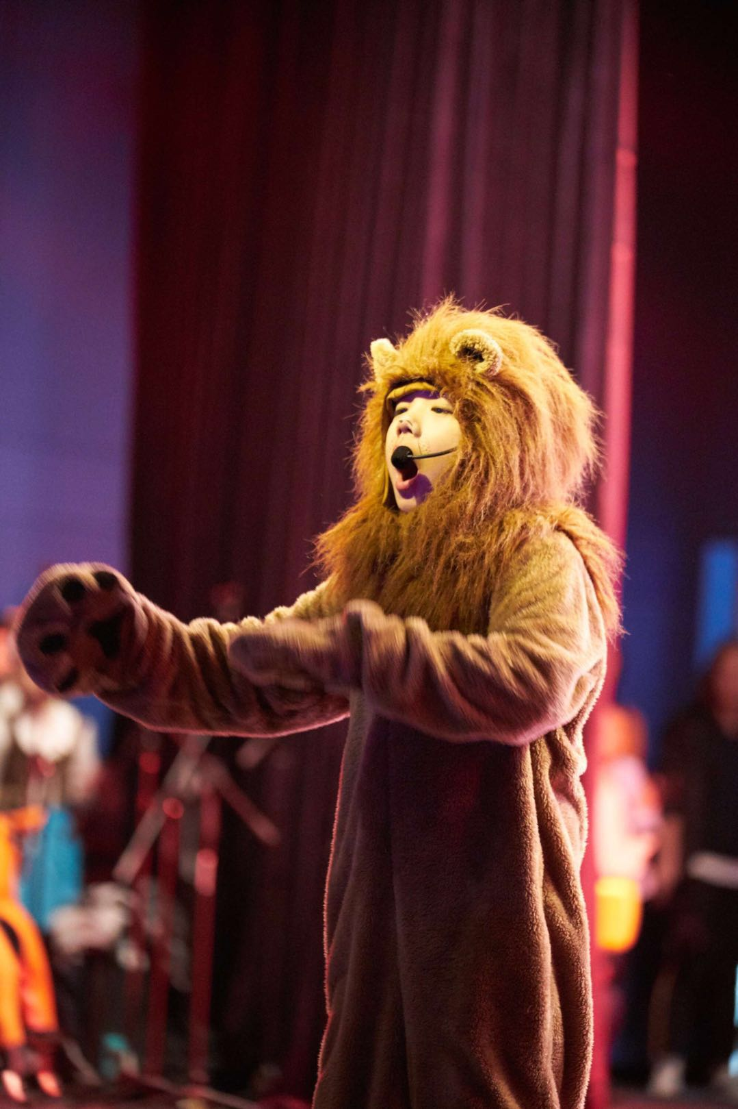
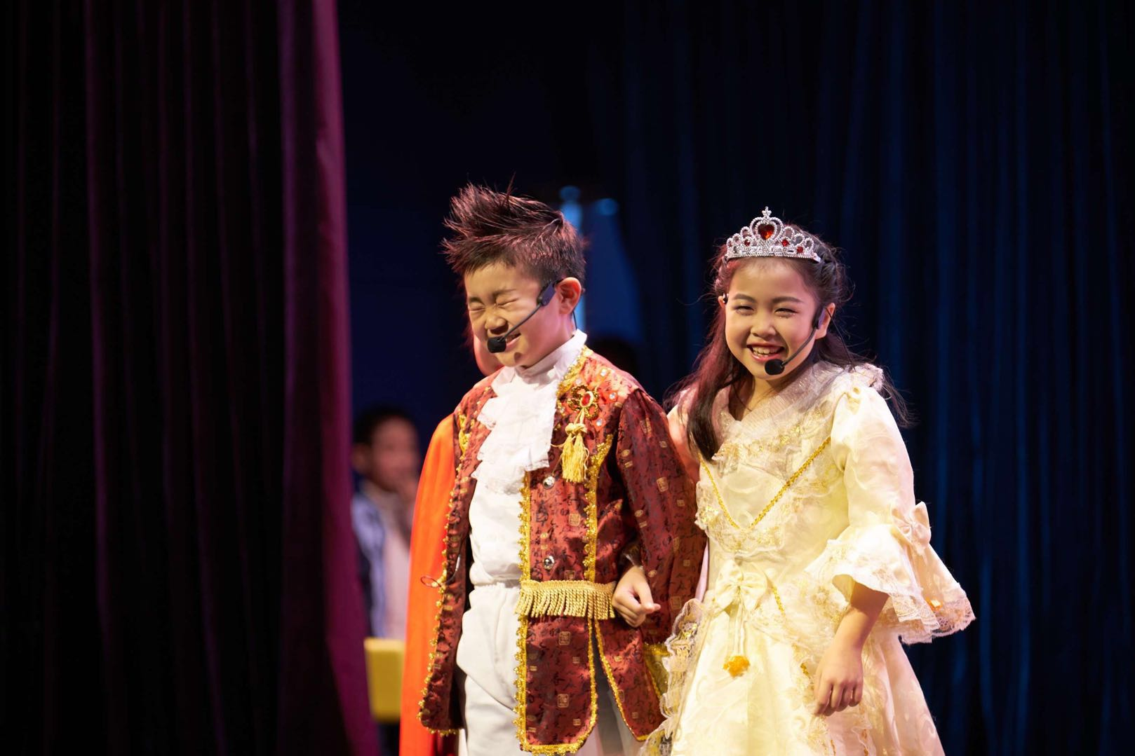
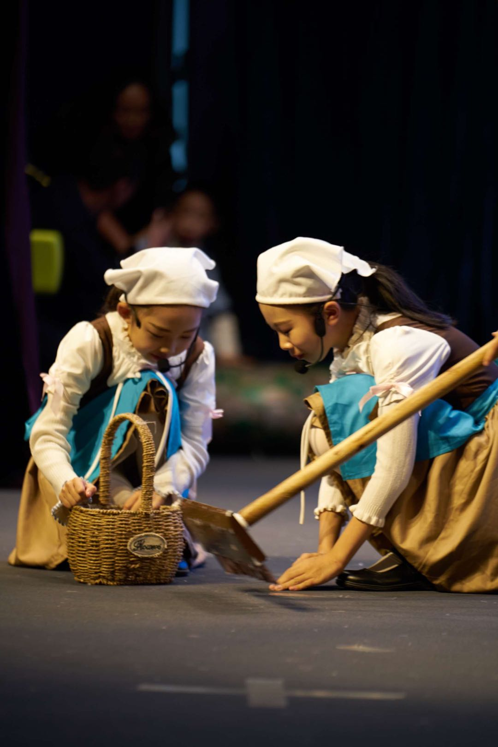
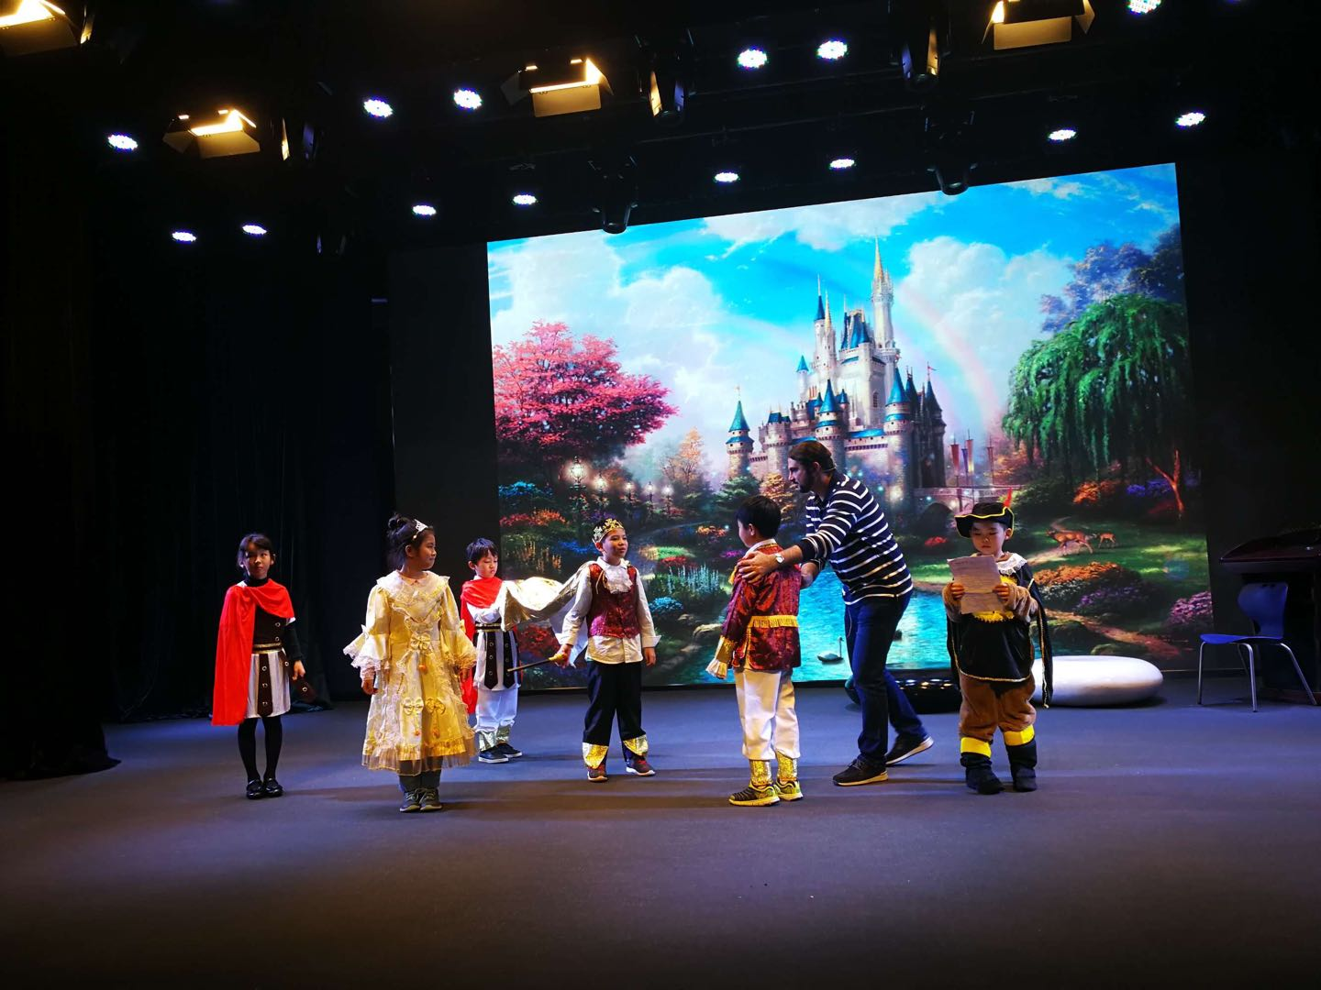
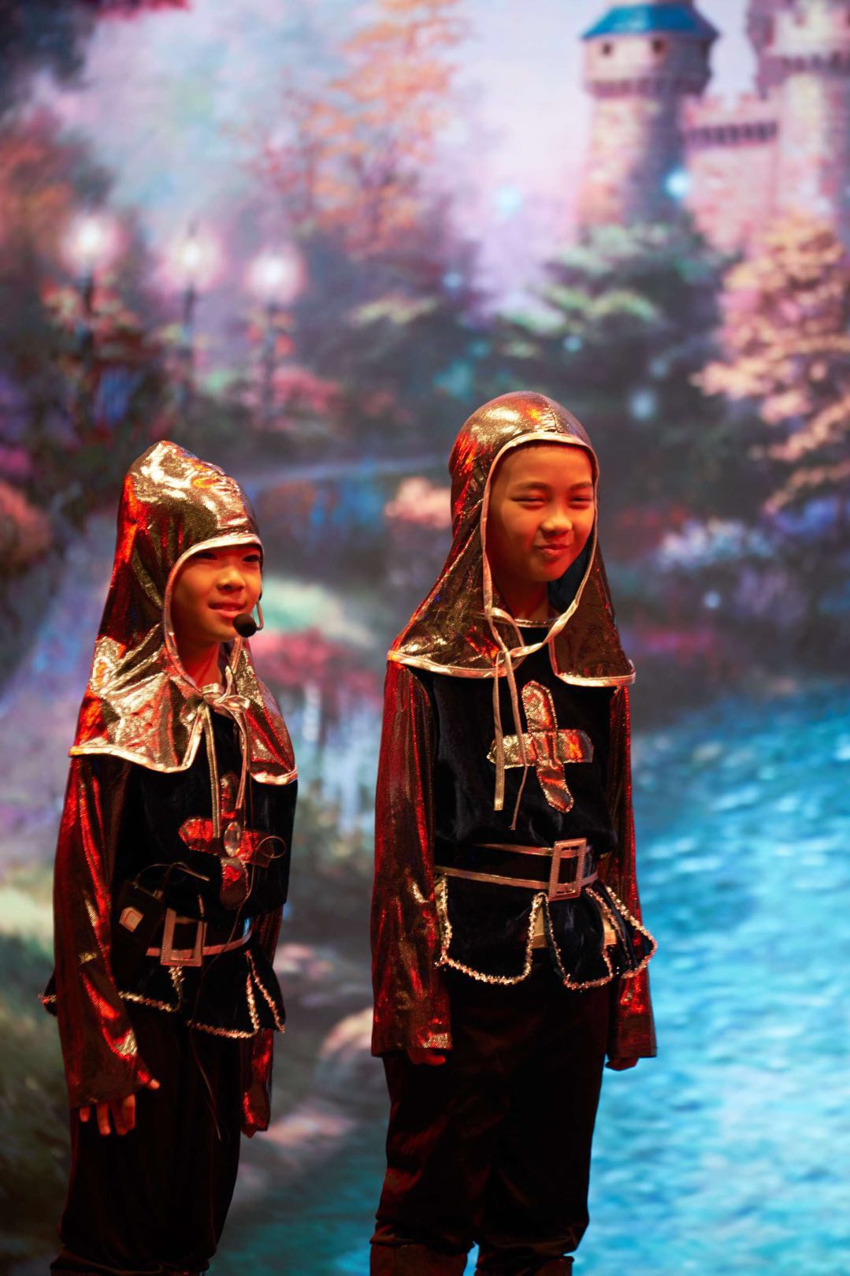
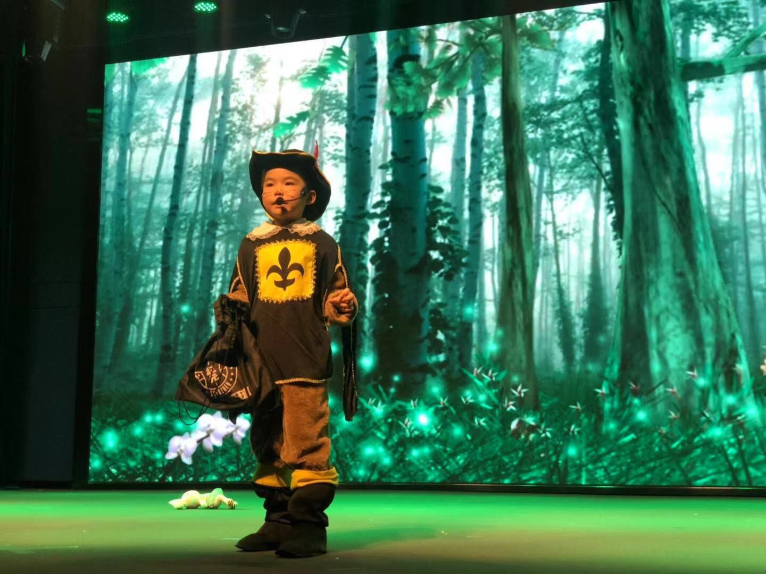

Slide 13
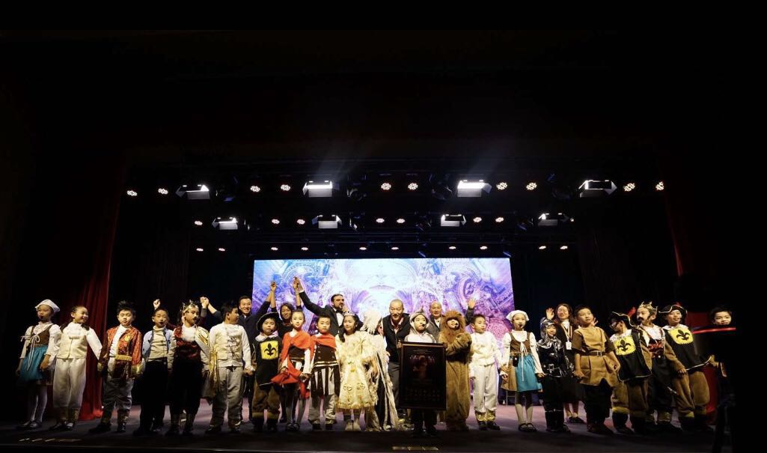

Slide 14
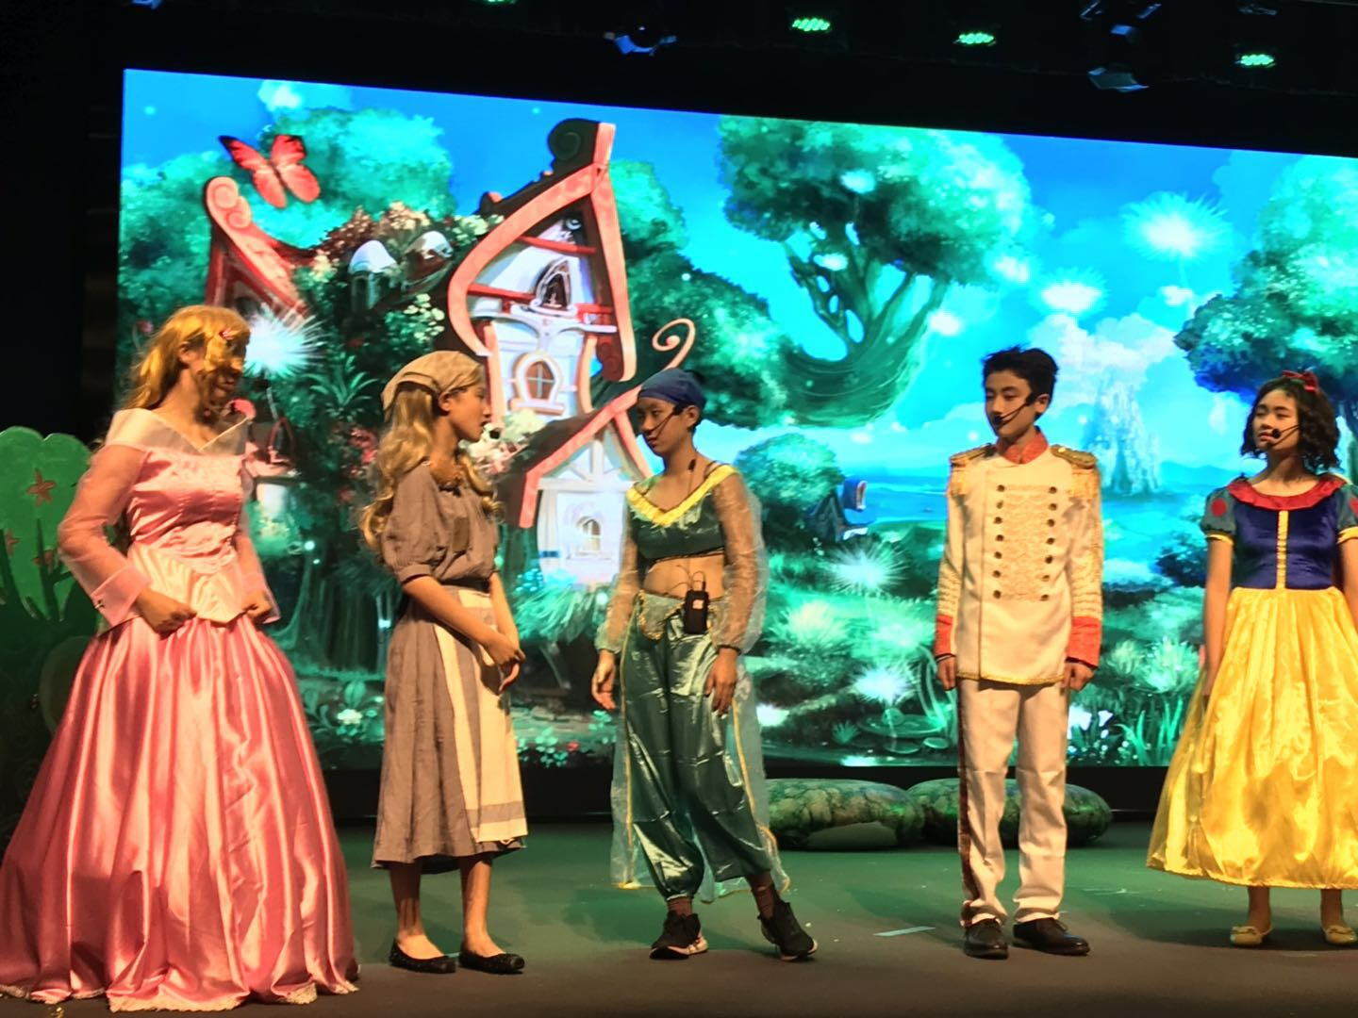
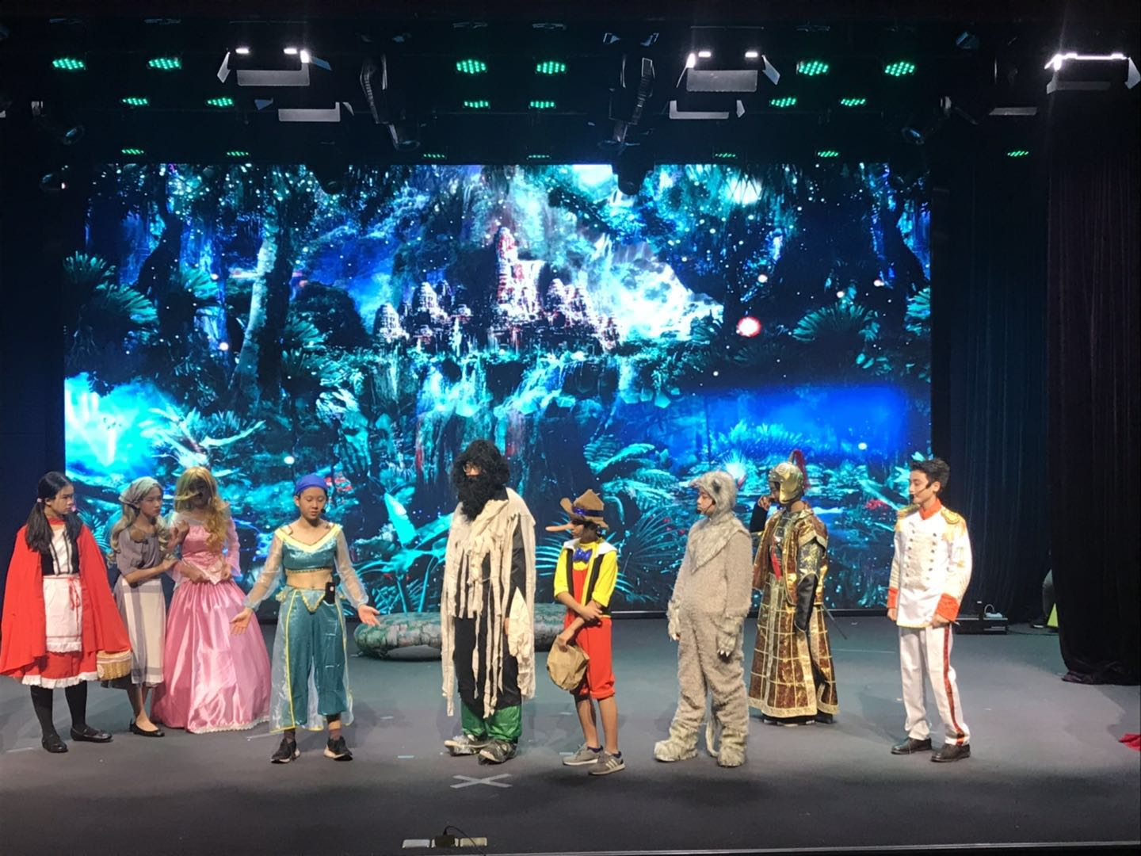

Slide 15
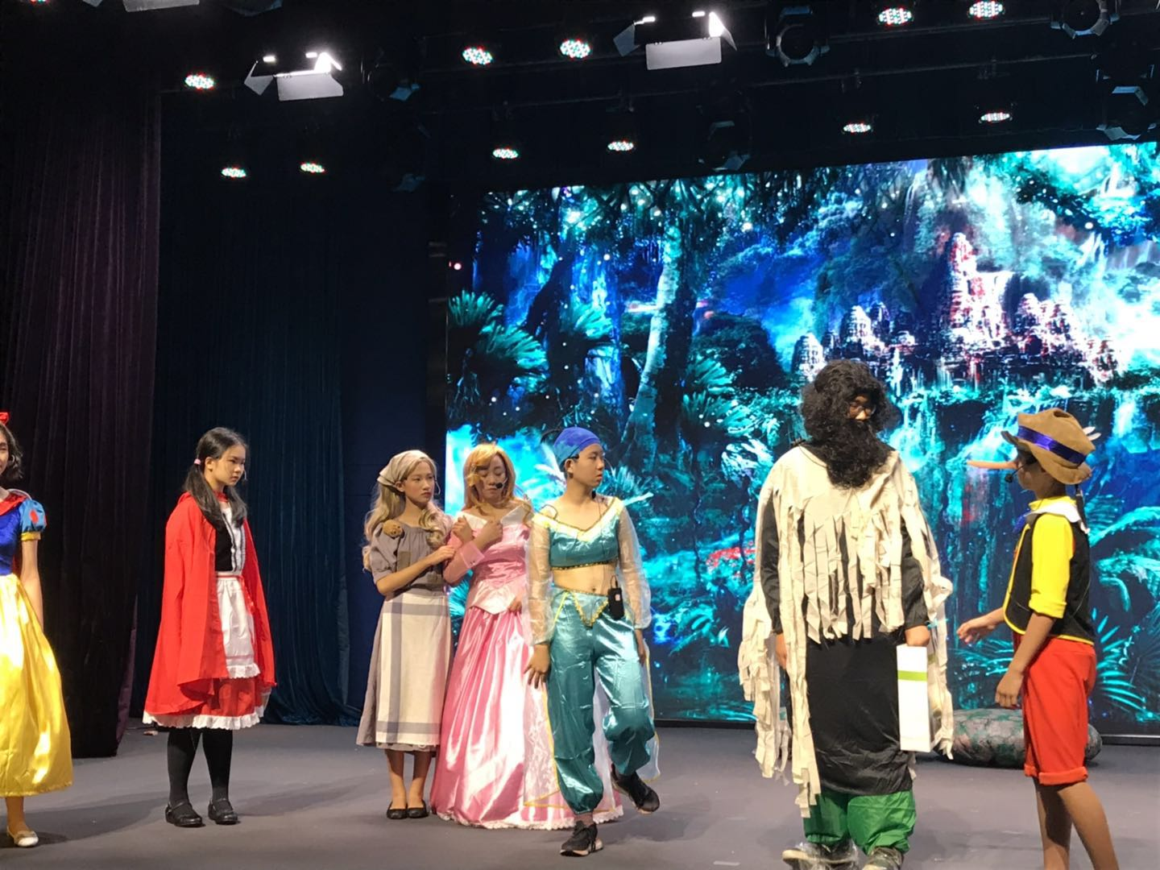
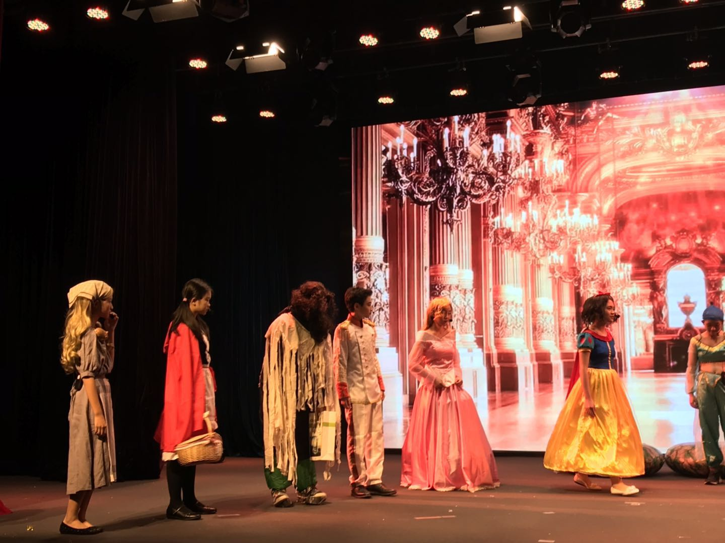
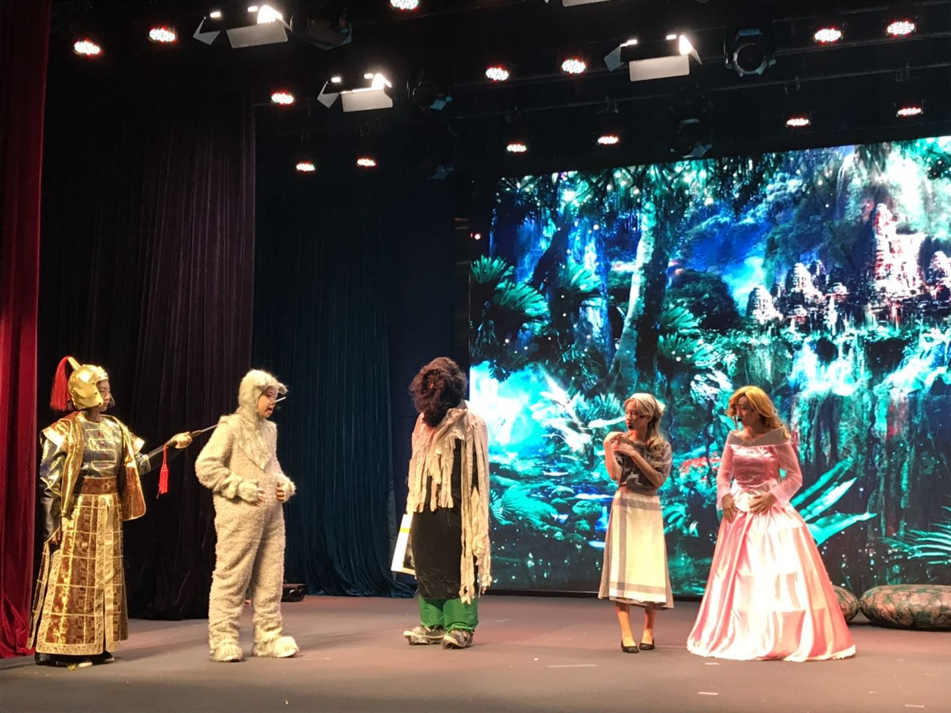
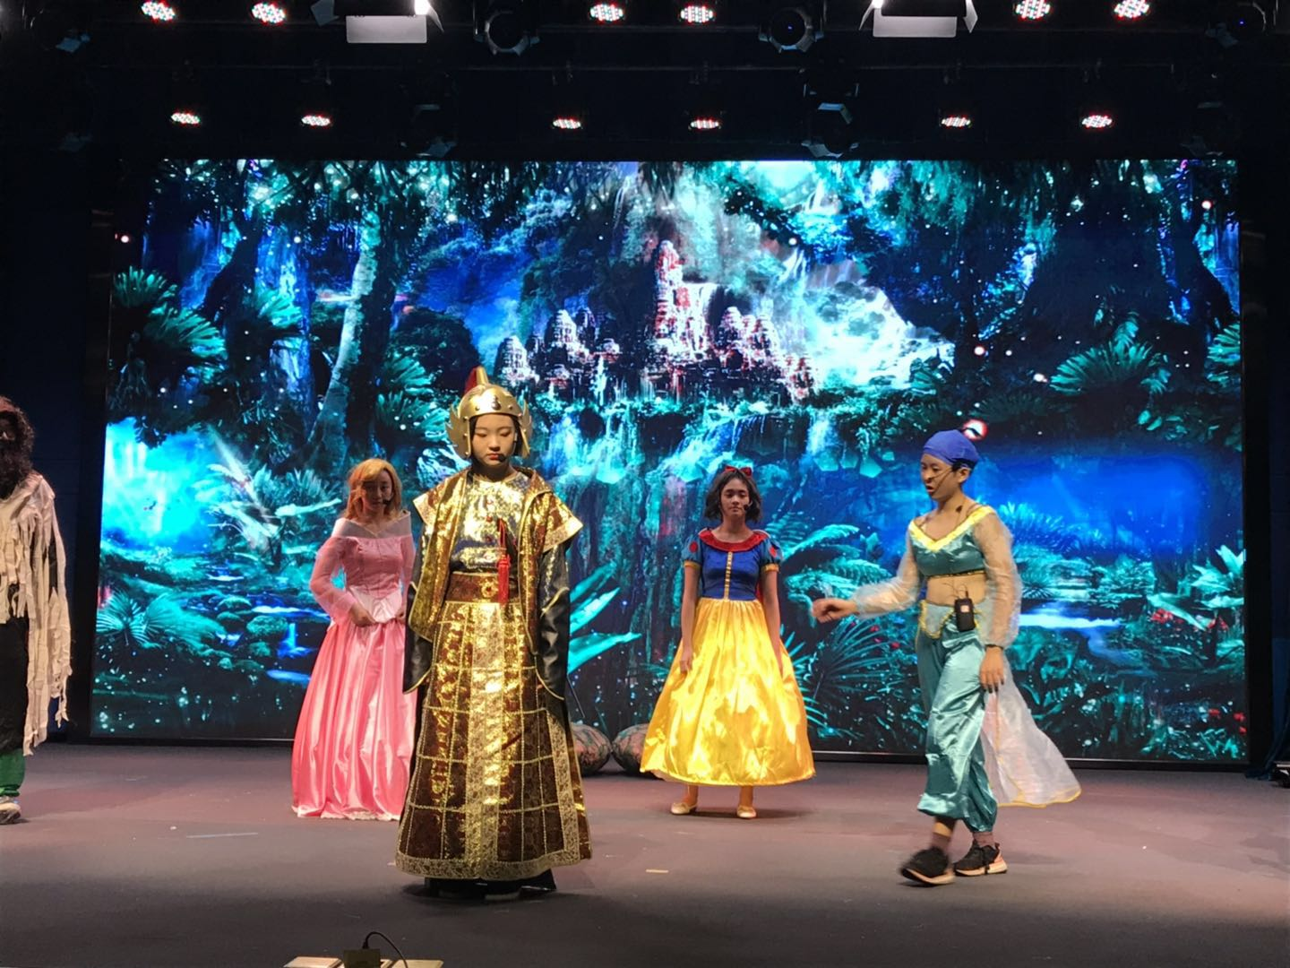

Slide 16
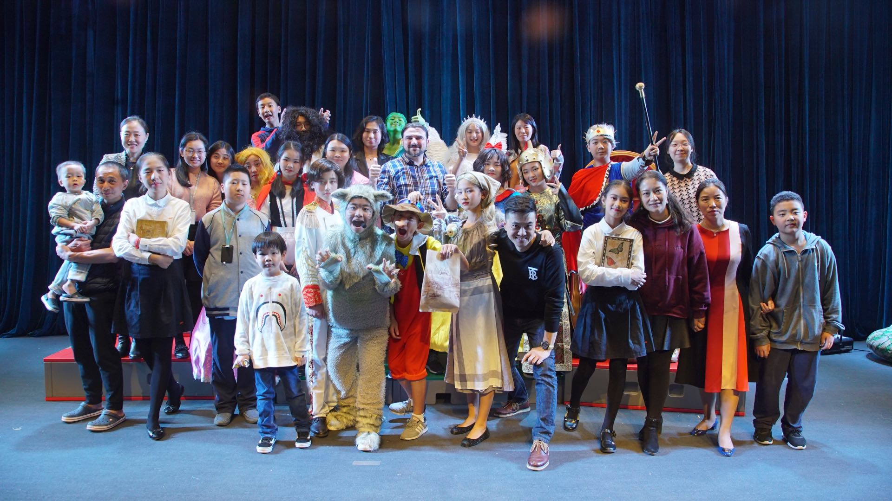

Slide 17
Other events
Halloween
Christmas

Slide 18
Halloween Event
Planning and designing the Haunted Theatre
Planning and executing the Halloween show for primary school and Middle school

Slide 19
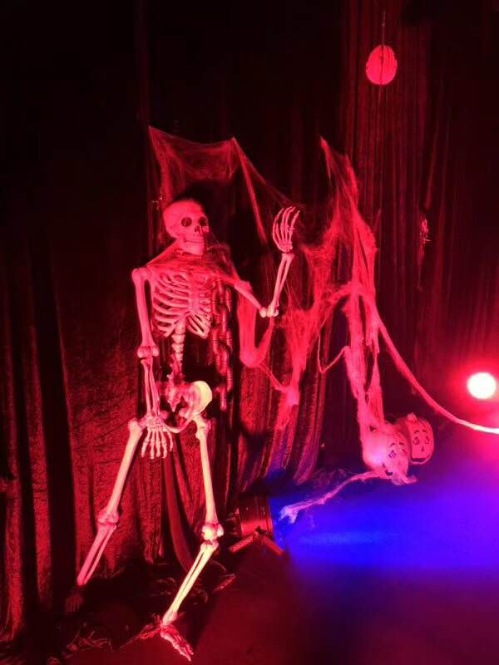
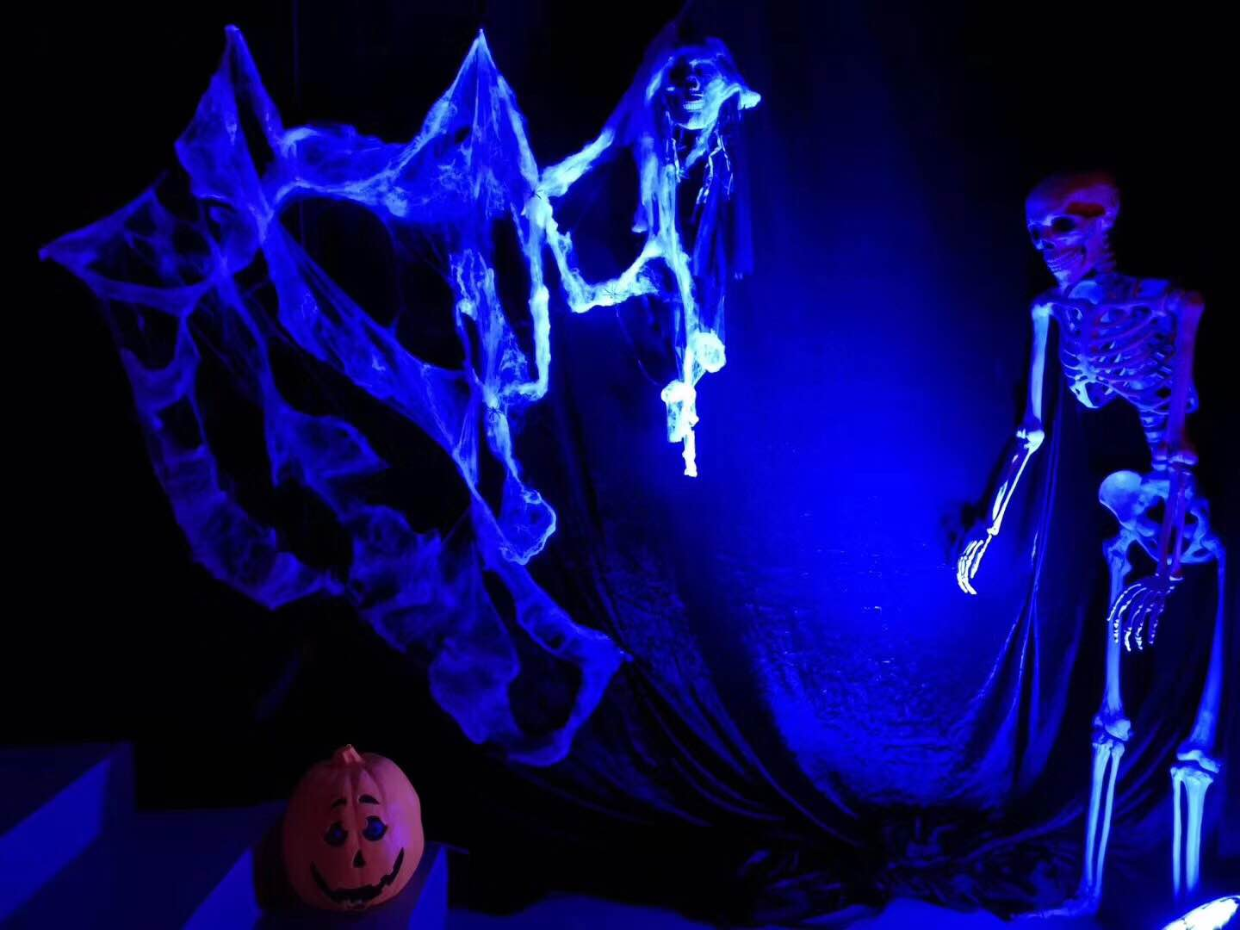
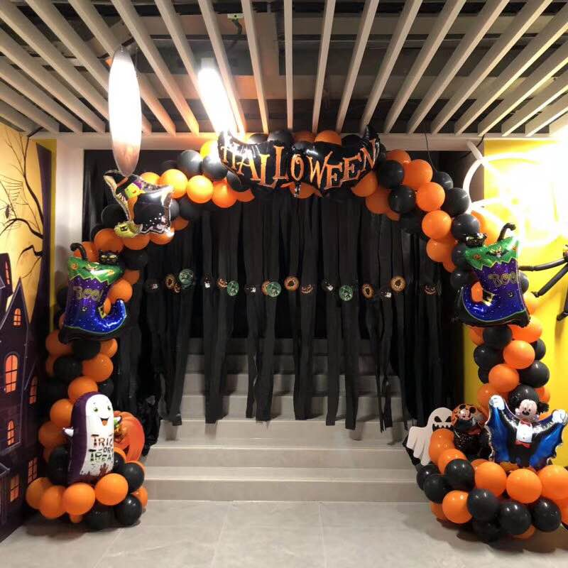
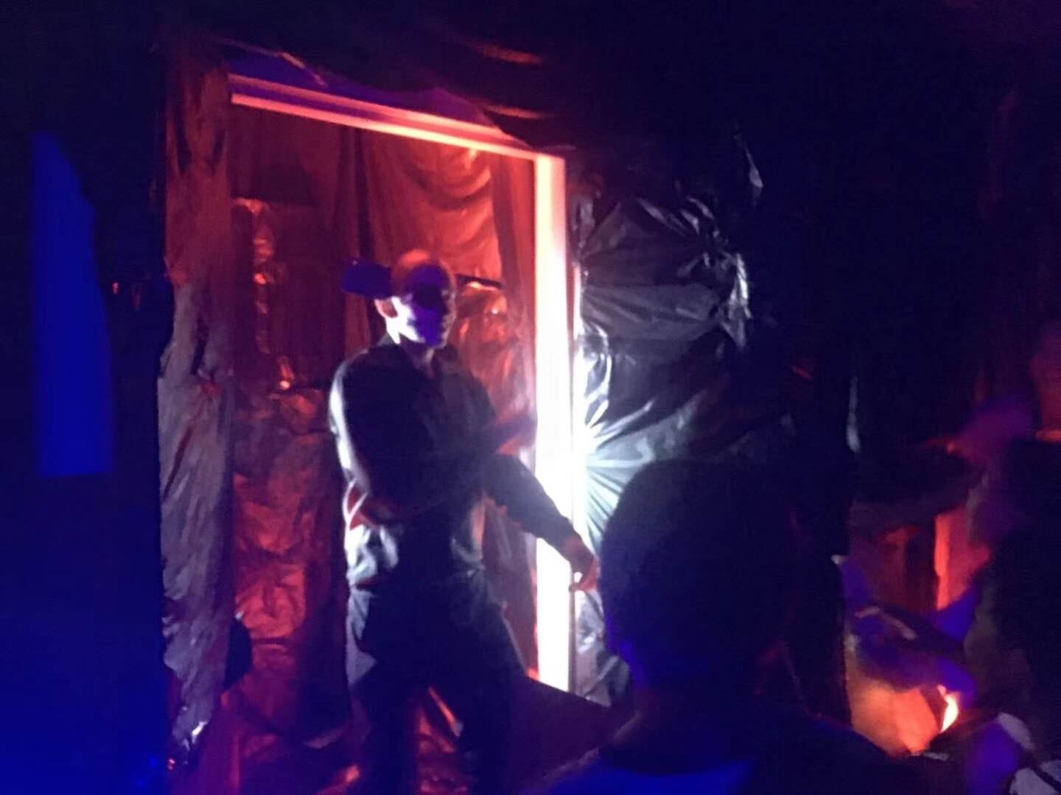
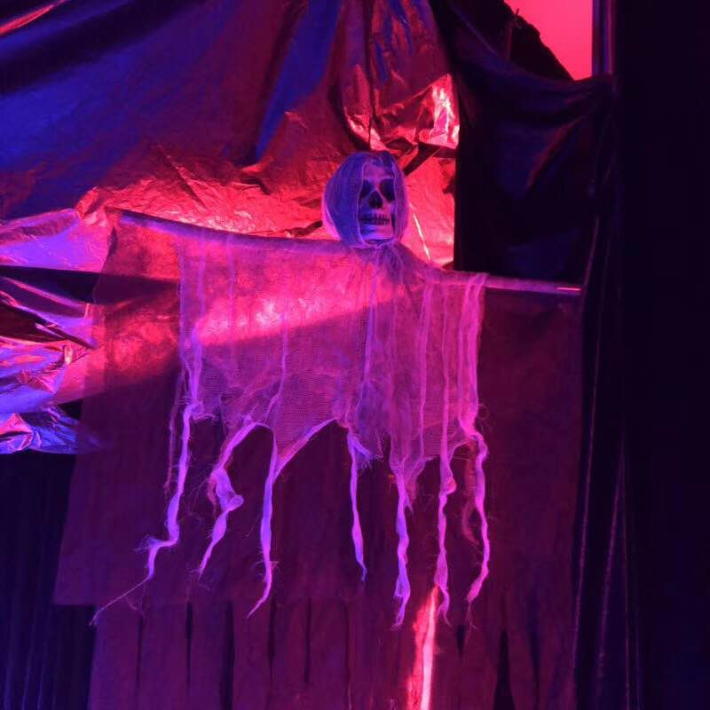

Slide 20
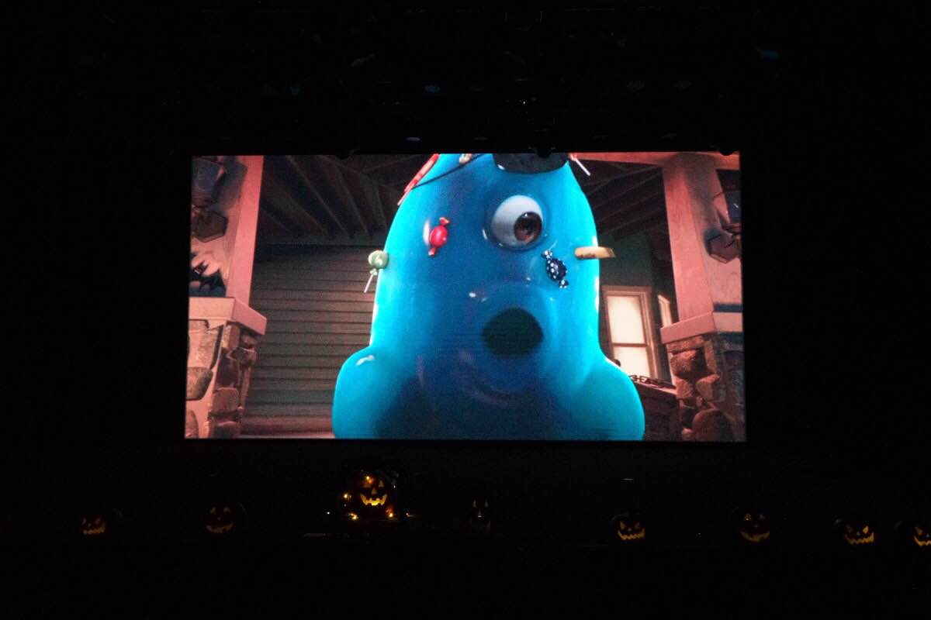
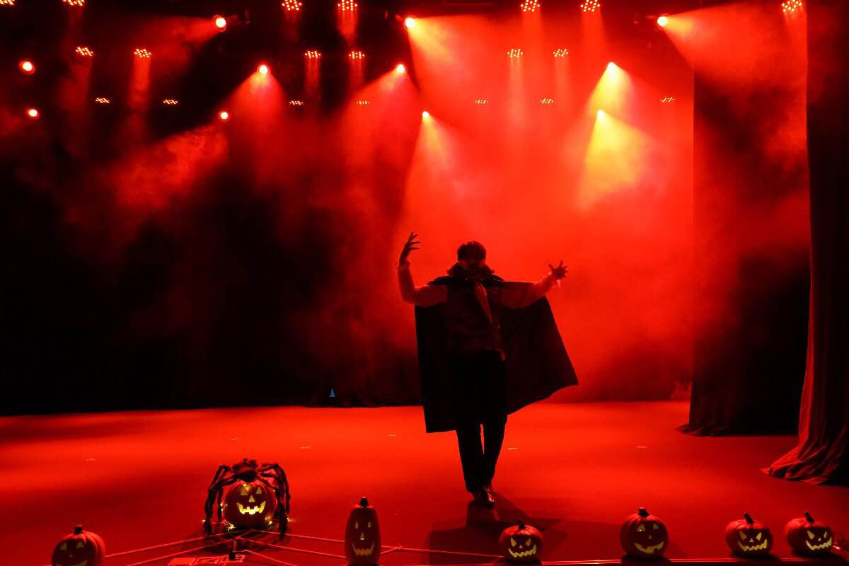
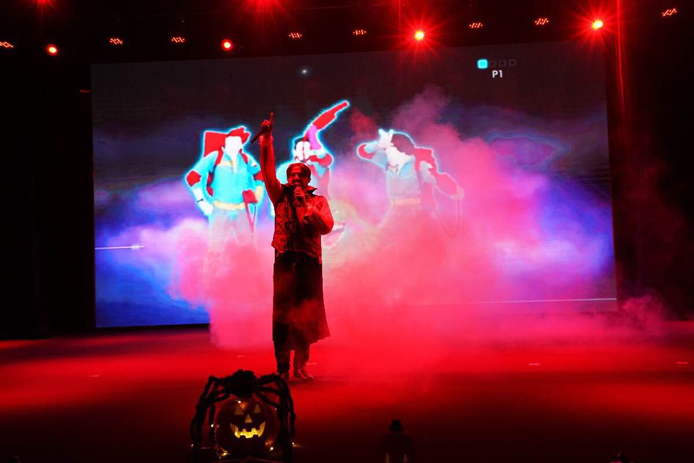
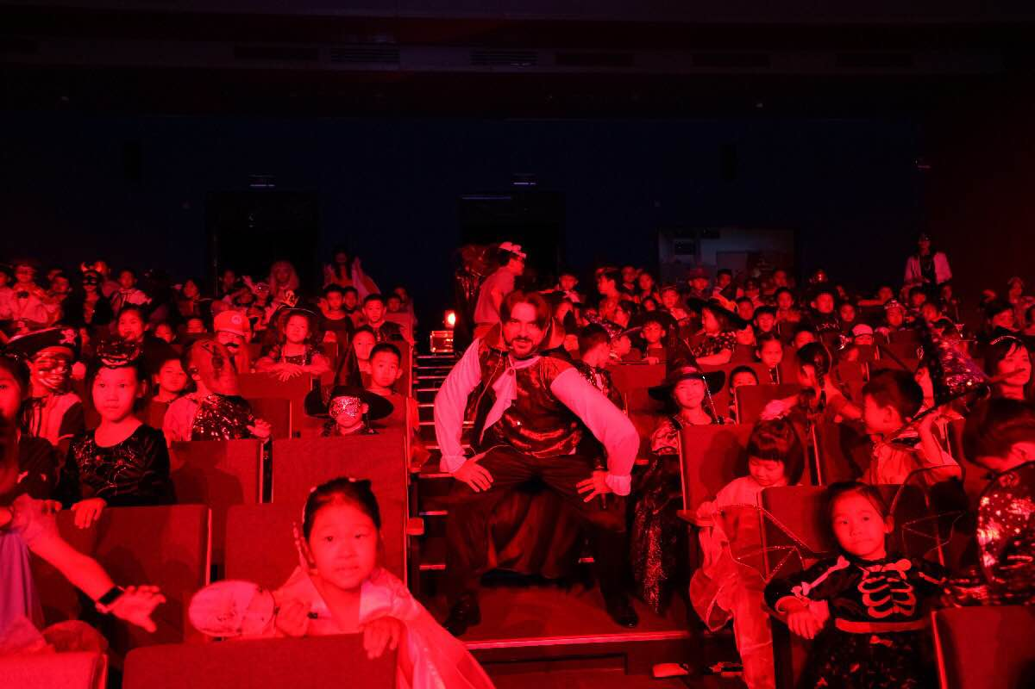

Slide 21
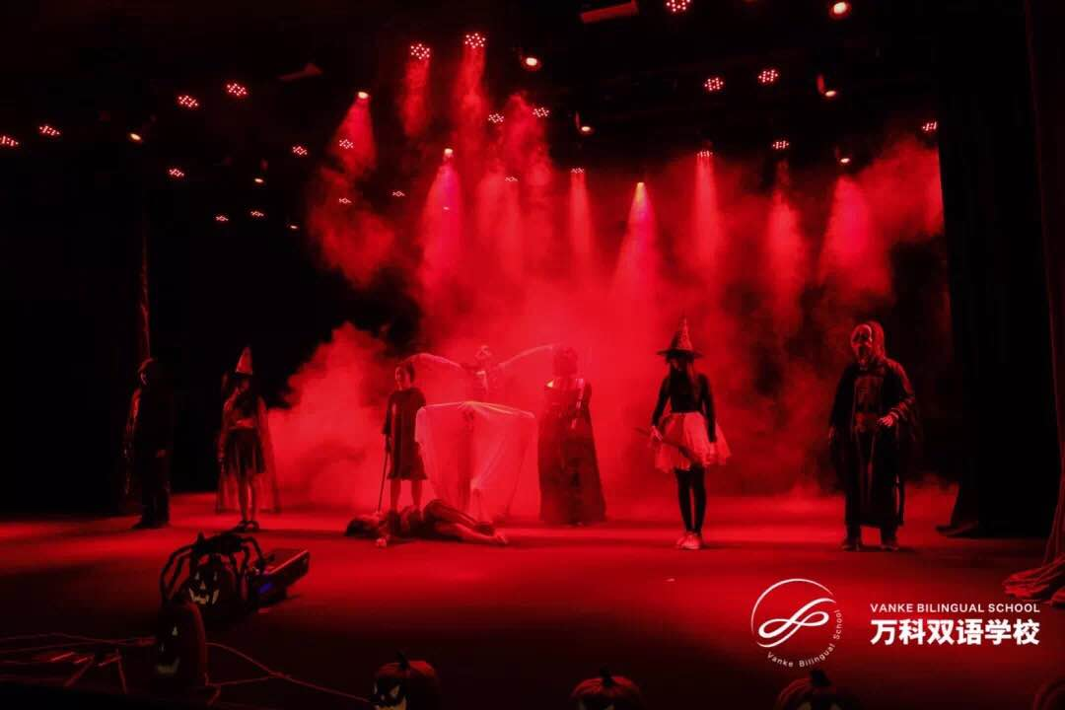
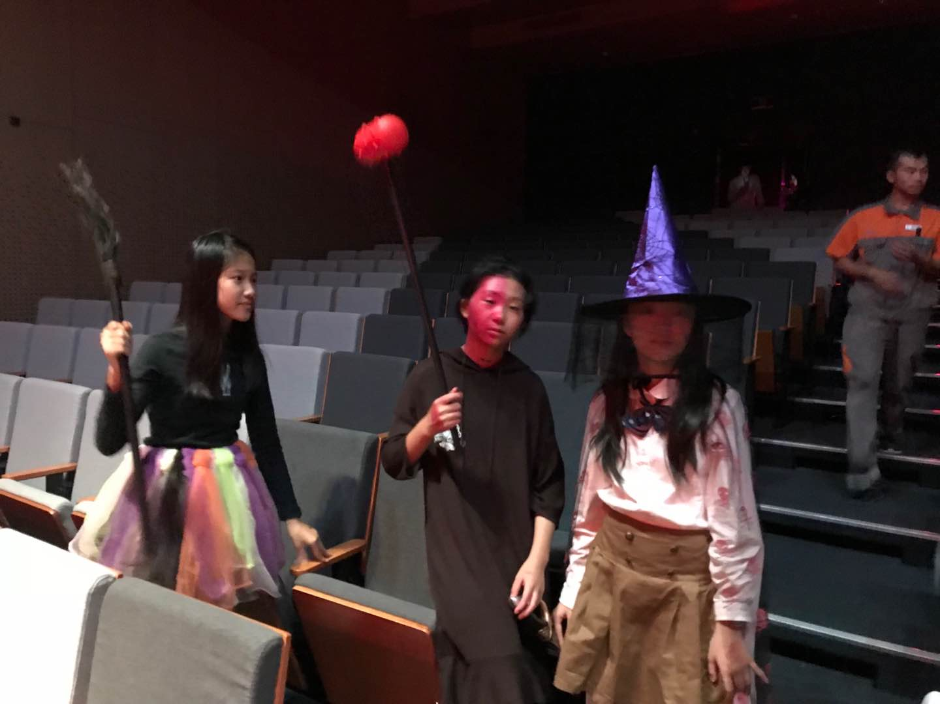
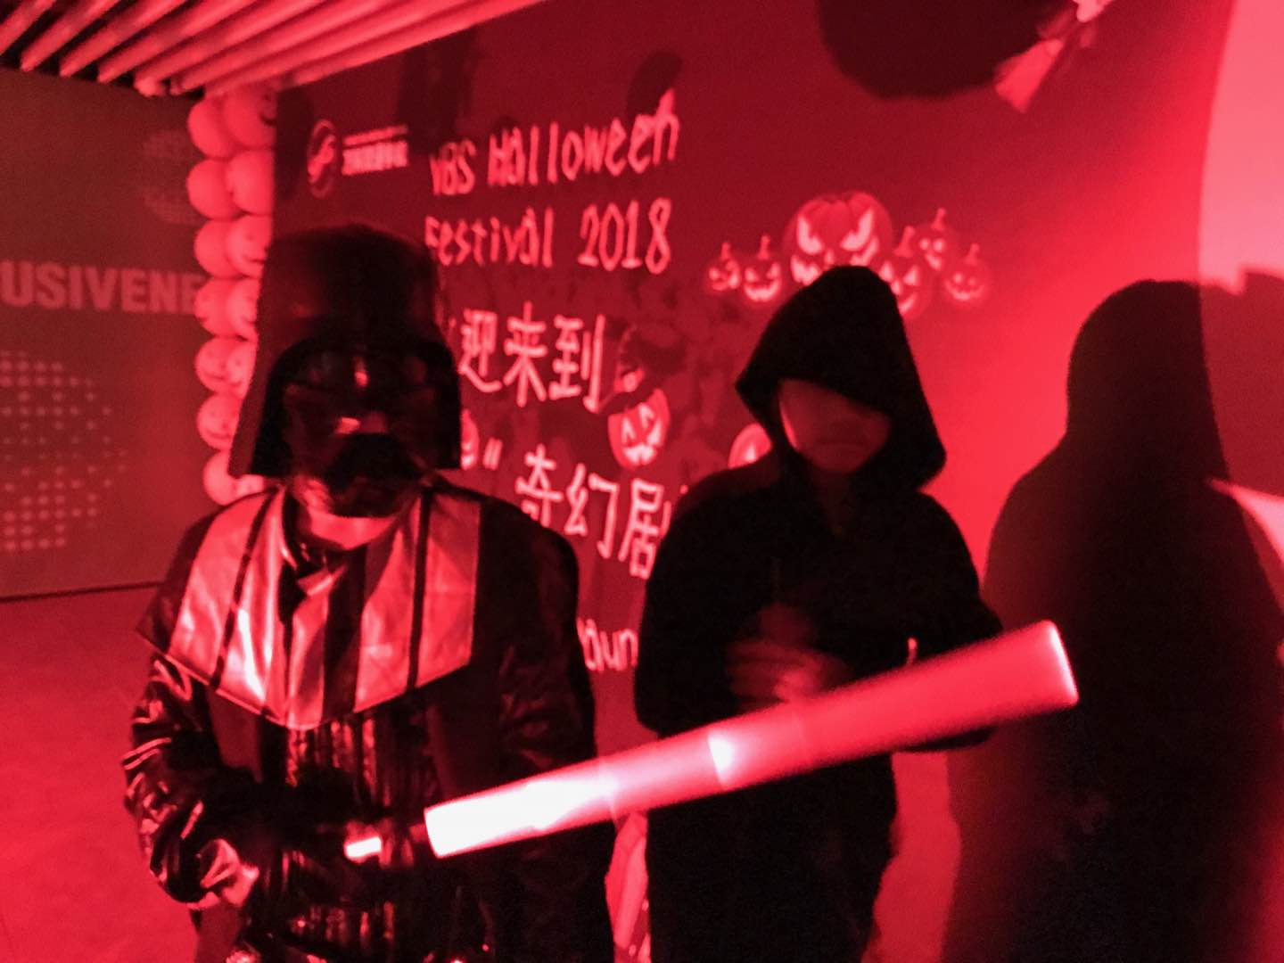
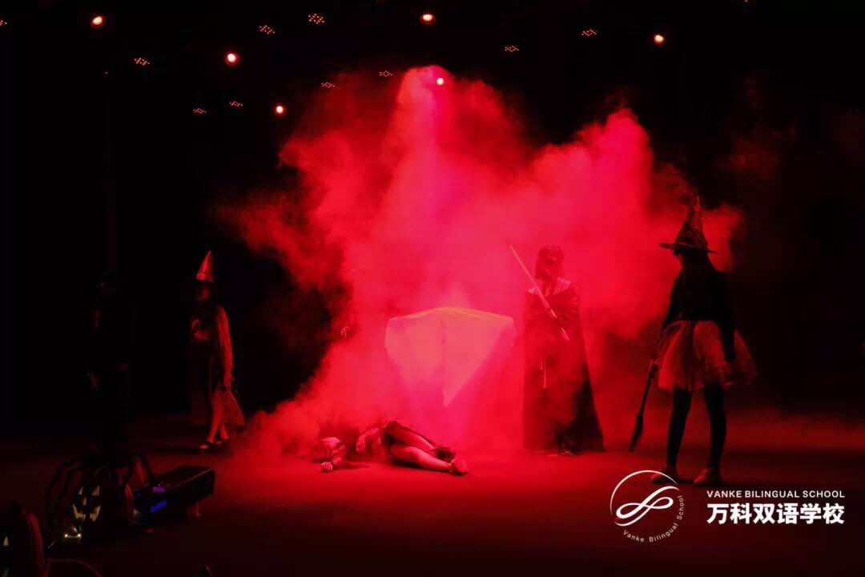

Slide 22
Christmas Event
Joined the Principal in Santa’s tour to all classes
Performing Jingle Bell Rock Song/show

Slide 23
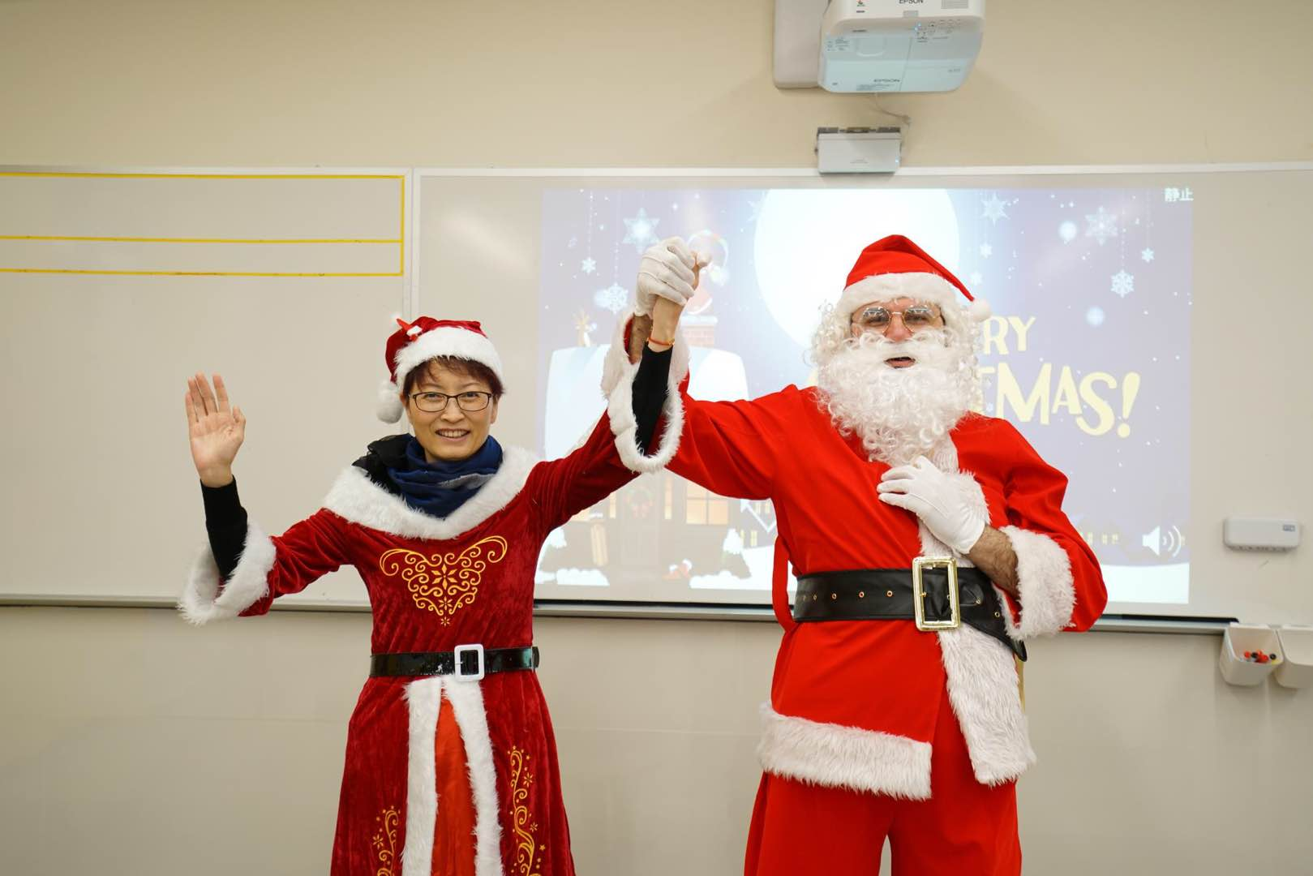
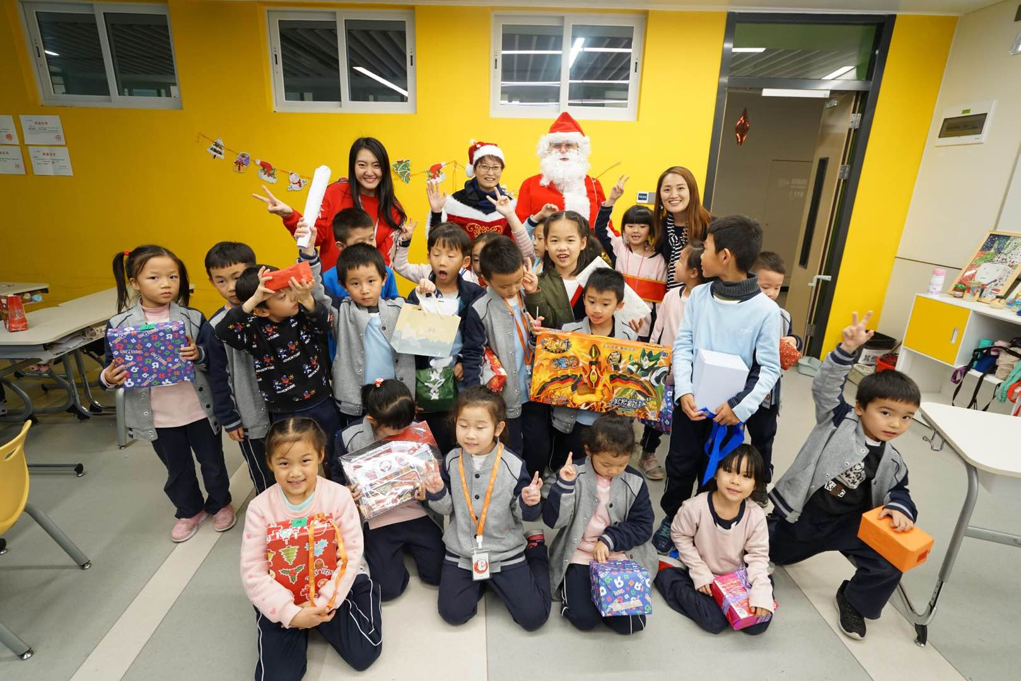
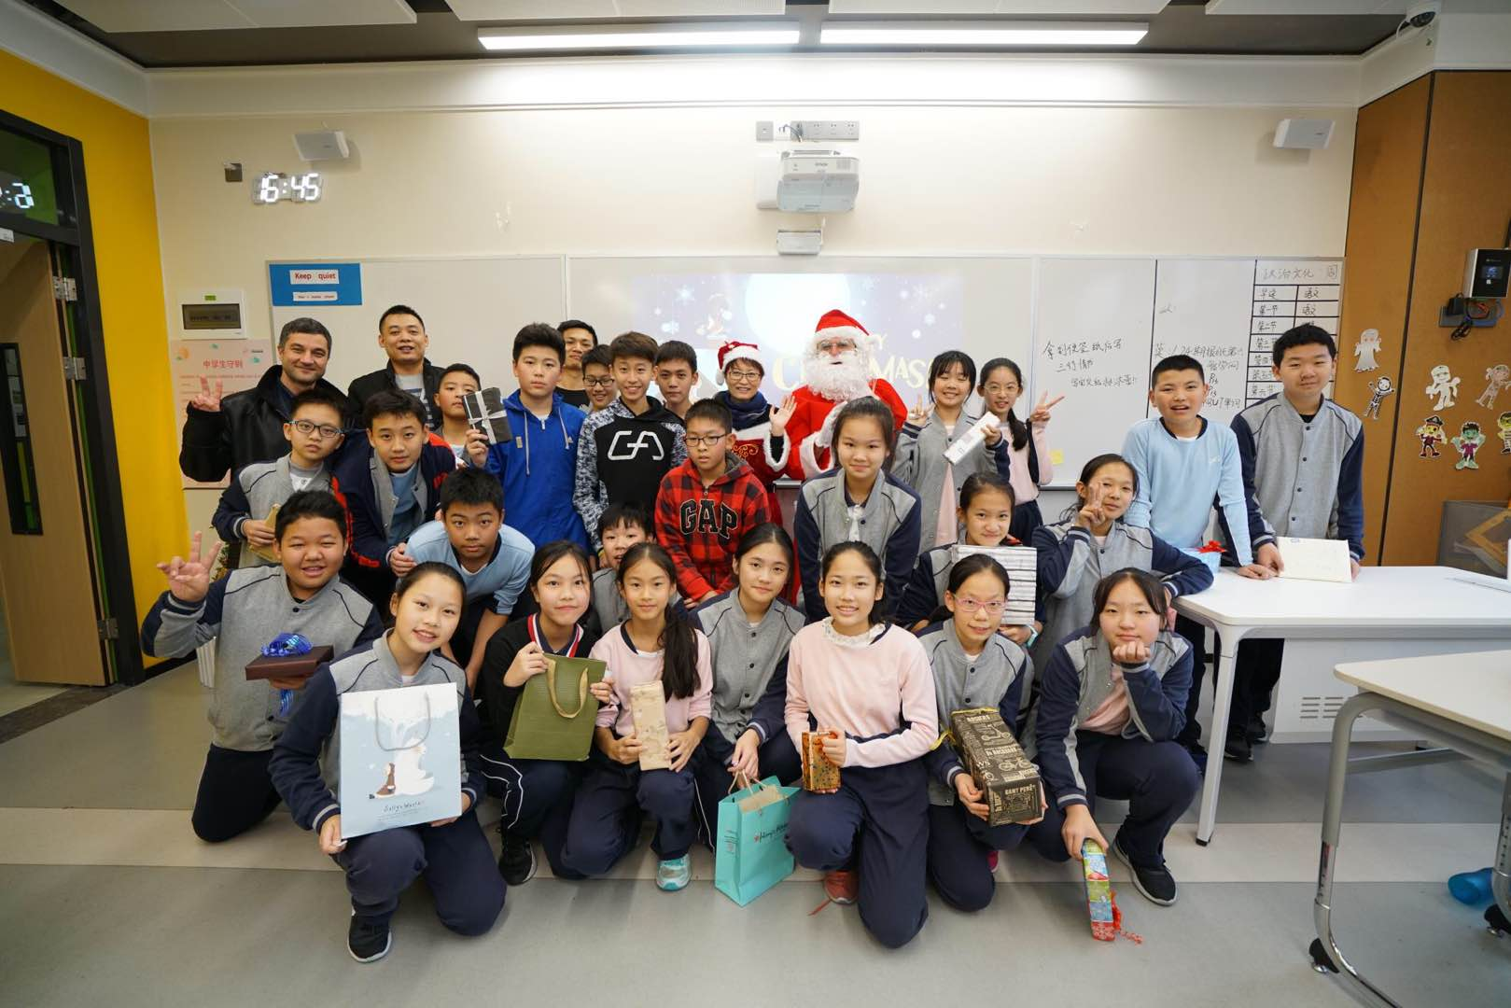
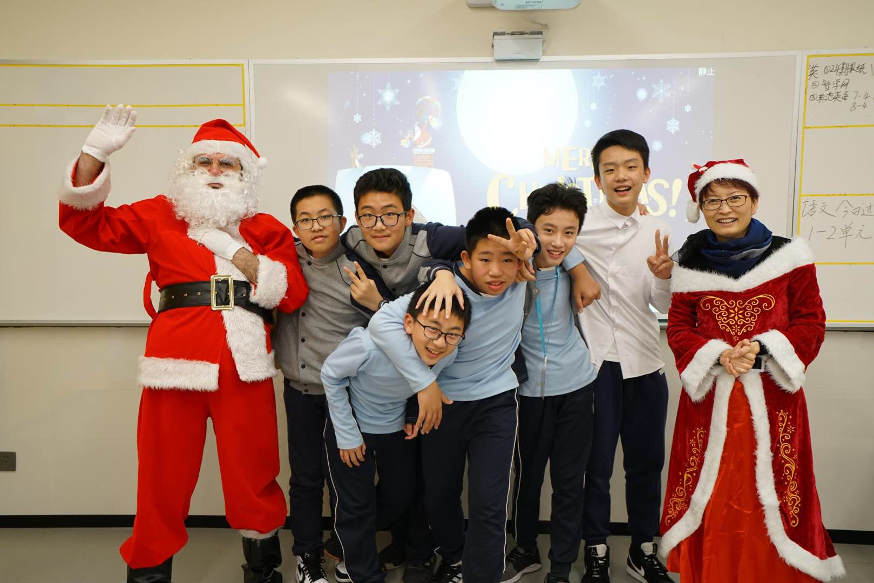

Slide 24

Next Semester Goals
First Acting Skills:
1- Voice skills and the ability to have dialogues
2- Improv Development

Slide 25

Next Semester Goals
Second
1- a Play for the Drama club
2- Plays for Primary school

Slide 26
Thank You

